Slide 1
Neural Networks &
Sales Models with Economic Indicators
Jiayue Meng, Veronica Chistaya, Ji Fang, Amy Feng,Peirong Hao, Bingyi Liu, Stephanie Wang, Kuixian Wu

Slide 2
Background
The advent of new sales models have brought countless profits to companies all over the world, allowing them to make future sales predictions and allocate resources more efficiently.
However, the training data came from before the Covid period; with the massive destruction of Covid, sales models have become far less accurate.

Slide 3
Proposition
Our goal is, by using a better sales model, we are able to make more accurate and useful sales predictions for post Covid era.
We hypothesize that by building a sales model using neural network with various economic indicators, we can obtain more accurate sales predictions for post Covid era.

Slide 4

Choice of datasets
Sales for Retail and Food Services from Federal reserve
· a retail sales dataset for all the united states, separated into 12 departments.
· we select time period since 2010 to avoid the 2008 recession.
· sales datasets are in monthly intervals.

Slide 5
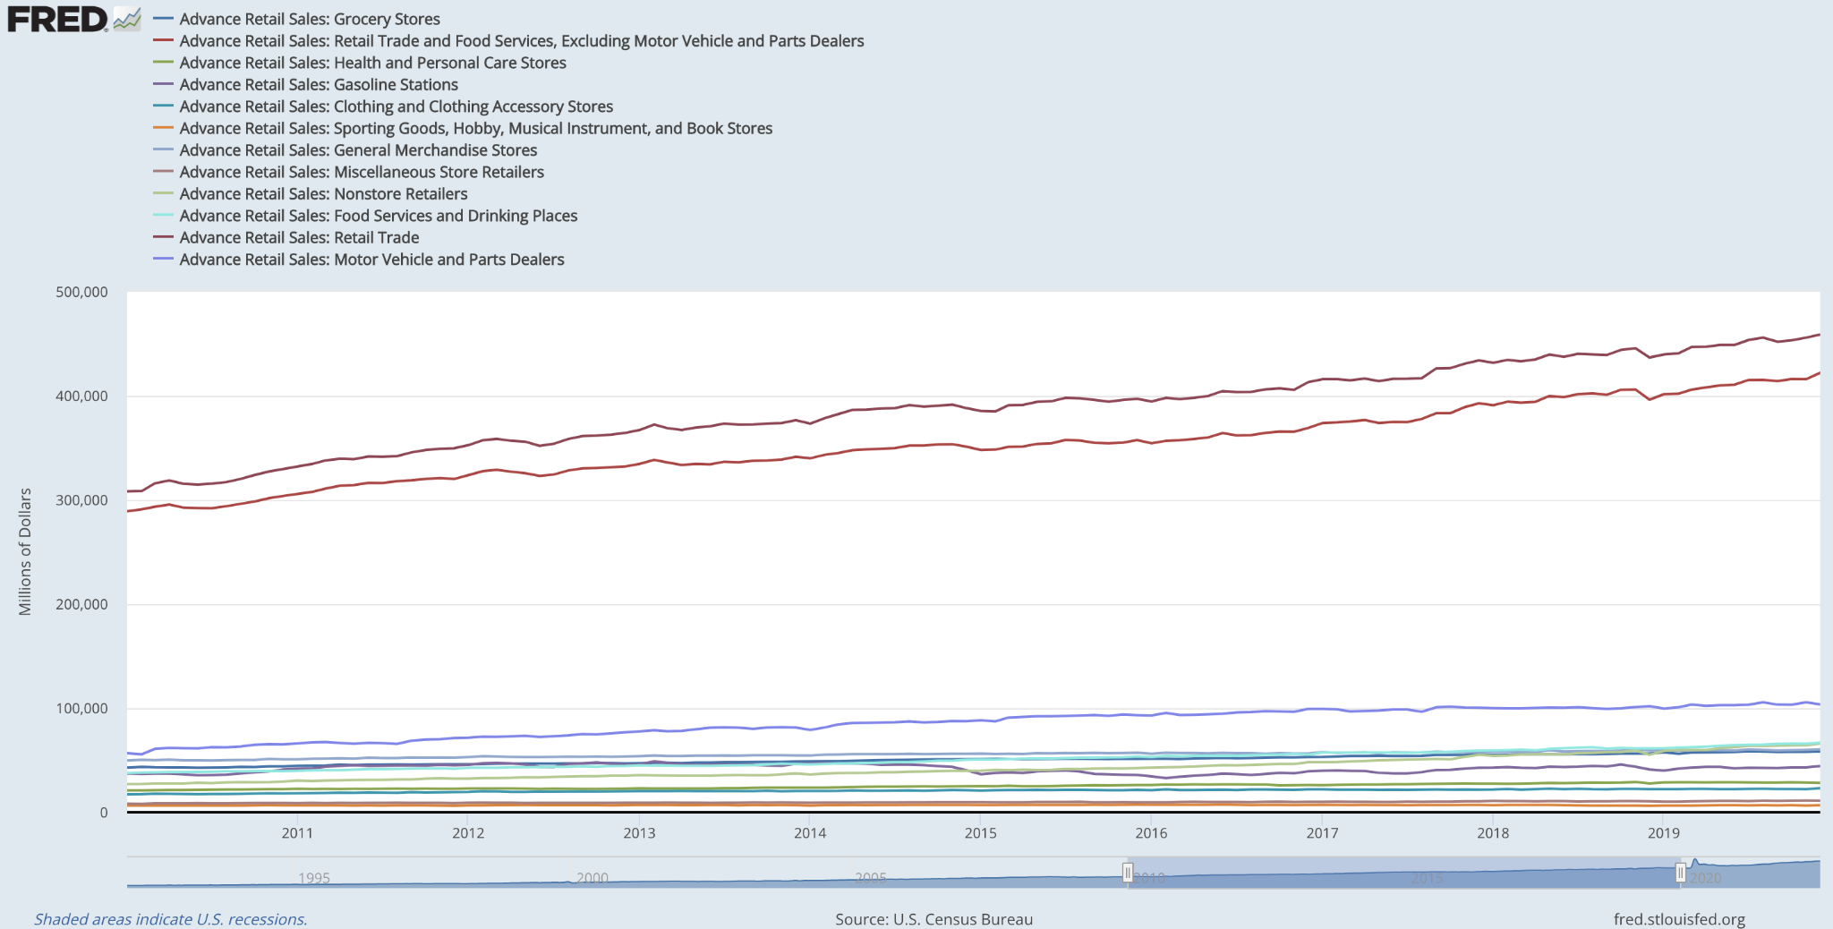
Graphical display of the datasets:

Slide 6
Running the model without economic indicators
We initially set the training period from January 2010 to December 2019 to test the model without the interference of Covid. We first ran the model without indicators to serve as a control to be prepared with results after indicators are added later.
(df_2010_2018Dec['RSHPCS'].std()-np.sqrt(loss))/df_2010_2018Dec['RSHPCS'].std()
The results are as follows:

Slide 7
Result without Economic Indicators
Sales | No indicators
RSAFS | -4.756594813
RSFSXMV | -1.885142956
RSHPCS | -1.777425538
RSGASS | -5.613283614
RSCCAS | -7.896371405
RSSGHBMS | 11.8160323
RSGMS | -5.635128272
RSDSELD | -9.991306149
RSMSR | -8.992442788
RSNSR | 1.915082126
RSFSDP | -0.582510438
RSXFS | -5.787082092
When there is no indicator, two departments had positive percentage of variance:
1. Sporting goods, hobby, musical instrument, and bookstores (RSSGHBMS)
Percentage of Variance = 11.8160323
2. Nonstore (online) retailers (RNSSR)
Percentage of Variance = 1.915082126

Slide 8
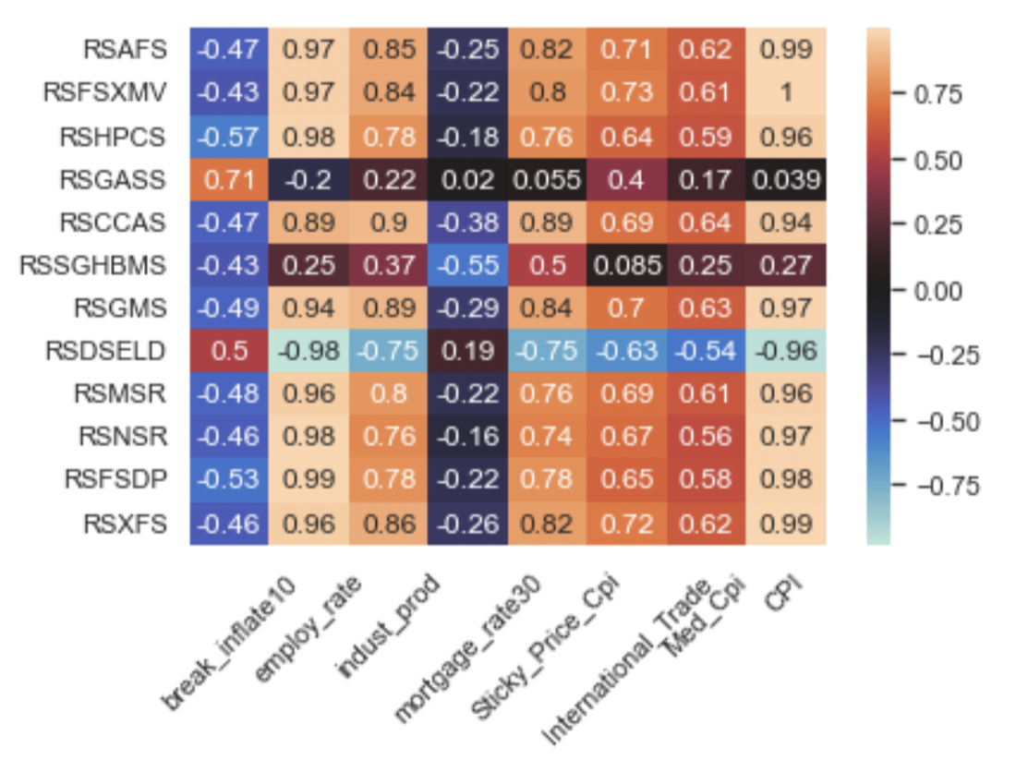
Adding economic indicators
Correlations to the sales departments
To improve the predictions, we selected a number of economic indicators with high correlations to the sales data:
CPI
Industrial production
10-year breakeven inflation
Employment rate
International trade: imports
Holidays

Slide 9
Results with economic indicators
Sales | break_inflate10 | employ_rate | indust_prod | International_Trade | CPI | Holiday | break_inflate10+employ_rate | break_inflate10+indust_prod | break_inflate10+International_Trade | break_inflate10+CPI | break_inflate10+Holiday | employ_rate+indust_prod | employ_rate+International_Trade | employ_rate+CPI | employ_rate+Holiday | indust_prod+International_Trade | indust_prod+CPI | indust_prod+Holiday | International_Trade+CPI | International_Trade+Holiday | CPI+Holiday
RSAFS | -6.525172813 | -4.963605851 | -3.703041185 | 25.63023545 | -3.135626561 | -4.710632485 | -4.492128933 | -3.628780729 | 24.98249315 | -3.310649549 | -5.256845165 | -3.844266523 | 26.11049519 | -3.247573996 | -4.344949101 | 27.55309015 | -2.286241121 | -4.766567946 | 26.37855409 | 25.76922354 | -3.369387226
RSFSXMV | -2.191538985 | -2.062224095 | -0.45661819 | 32.03542641 | -1.436615089 | -1.648522385 | -1.294788206 | -0.58290309 | 30.28423273 | -0.402313829 | -2.204354263 | -0.28875752 | 29.24783468 | 0.321770722 | -2.548697963 | 30.45535235 | 1.212354 | -1.038443492 | 31.05089137 | 29.22033161 | -0.323069879
RSHPCS | -1.616650555 | -3.8767661 | -0.855229131 | 30.28723719 | -1.438403027 | -1.716794142 | -1.257205431 | -3.551011063 | 31.09508831 | 0.358791728 | -1.272654403 | -1.924343438 | 29.59223155 | -0.010802667 | -0.716984136 | 22.63910482 | 0.970124873 | -3.036264085 | 21.00338008 | 29.60482257 | 0.291383303
RSGASS | -7.944046516 | -19.41675508 | -6.126989898 | -0.572399943 | -7.611307335 | -8.245951436 | -6.936650854 | -9.177158555 | 2.916255892 | -14.82546061 | -10.15434685 | -5.426115856 | 1.084965797 | -14.96871612 | -10.76975251 | -6.710402914 | -7.789665682 | -9.716573722 | -9.215110507 | 0.567305494 | -7.706294221
RSCCAS | -7.441458343 | -7.380348316 | -6.127426025 | 32.2135936 | -6.251030154 | -10.69594441 | -7.427305515 | -11.3625393 | 23.26365284 | -5.503519565 | -7.357243327 | -6.406058878 | 31.98508582 | -4.960658833 | -8.256866286 | 30.36657817 | -4.24284439 | -5.694287414 | 32.48801351 | 29.66821298 | -8.212760455
RSSGHBMS | -33.84788782 | 19.03100016 | -121.0803672 | -0.11742429 | -33.91794945 | -75.31920379 | -4.361170017 | 15.44514856 | 6.774772521 | -26.17576578 | -40.13708529 | 12.34479038 | 11.60738544 | -54.35823006 | 16.4209993 | 16.14015847 | -11.58223057 | -3.405056531 | -32.06126576 | -69.63323654 | -15.22485203
RSGMS | -12.16424303 | -4.75618758 | -7.427834489 | 29.75067249 | -6.612025381 | -17.57009717 | -7.816269888 | -6.44003182 | 17.91706442 | -2.993682478 | -18.57465729 | -4.430434612 | 28.15190111 | -3.603350268 | -13.16614376 | 28.4975027 | -1.33968535 | -3.277158882 | 28.97213109 | 29.46063974 | -4.741398481
RSDSELD | -14.3076017 | -5.752721426 | -4.814076274 | 22.93282133 | -6.952848234 | -9.91697268 | -2.893805779 | -6.71972976 | 16.62009863 | -7.781707615 | -7.832650309 | -11.07623835 | 11.37595408 | -12.56103172 | -4.577734089 | 11.1931908 | -10.03002332 | -7.878687218 | 17.94300888 | 24.88136331 | -12.3061318
RSMSR | -10.90643919 | -9.789154747 | -6.216391396 | 28.56774882 | -32.32991955 | -7.614398103 | -8.536359863 | -5.589296349 | 31.9090699 | -16.6343049 | -6.686453905 | -5.643618774 | 12.8507472 | -8.381057473 | -18.57095083 | 30.5429639 | -15.89880778 | -6.507569965 | 31.5047495 | 30.41679371 | -11.39440246
RSNSR | 1.145527375 | 2.168300889 | 1.844379011 | 24.66659104 | 1.395600773 | 1.056036496 | 0.704858866 | 1.729762775 | 18.882376 | 2.028614485 | -0.389581177 | 0.875608737 | 20.81957954 | 1.878835992 | 1.743144271 | 21.17689809 | 1.879235861 | 2.027338627 | 23.04328543 | 23.5367683 | 2.727603214
RSFSDP | -0.361368171 | -0.575037884 | -1.579500037 | 23.61552896 | 0.587087773 | -1.800907137 | -0.346609181 | 0.236507208 | 21.76222127 | -0.02005586 | -3.315636748 | -0.542263948 | 22.8523625 | -2.213799651 | -0.253798551 | 22.6888969 | 1.043045538 | 0.002709945 | 23.36309681 | 23.47433521 | -0.037952894
RSXFS | -6.453343972 | -5.30089568 | -4.889563901 | 28.17980296 | -4.193339787 | -5.830604798 | -10.65279356 | -4.605135573 | 28.26255921 | -5.321296549 | -5.803045716 | -4.582174223 | 27.0379096 | -4.423746734 | -5.852901671 | 26.40641764 | -3.254852977 | -4.728583417 | 29.00548788 | 24.72058805 | -4.049320996

Slide 10
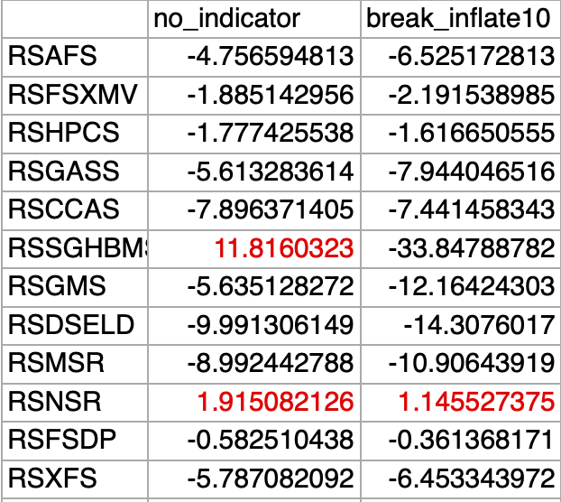
What Didn’t Work
10-year Breakeven Inflation
Only 1 out of 12 departments (RSNSR) had positive percentage of variance explained. In many departments, the variance became even more negative.
One possible reason is businesses are not equally affected by inflation.
Inflation, however, when combined with imports, improved results and are discussed later.

Slide 11
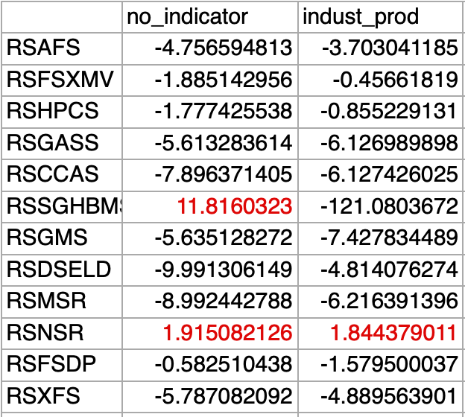
What Didn’t Work:
Industrial production:
Only 1 out of 12 departments (RSNSR) had positive percentage of variance explained.
Industrial production index measures the levels of production and capacity in the manufacturing, mining, electric, and gas industries, relative to a base year.

Slide 12
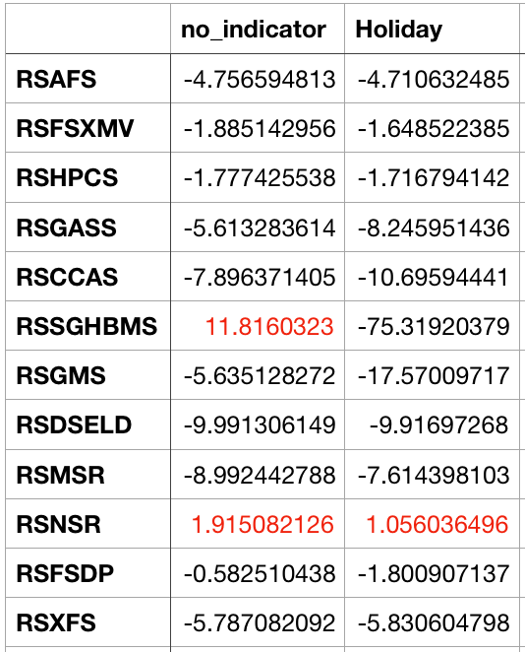
What Didn’t Work:
Holidays
Sales fluctuate before or during holidays, thus we anticipated to see improvements in our prediction.
Insignificant changes when holidays are added as a regressor.
We hypothesize that since the datasets are seasonally adjusted, holidays may already been taken into account in the sales data.

Slide 13
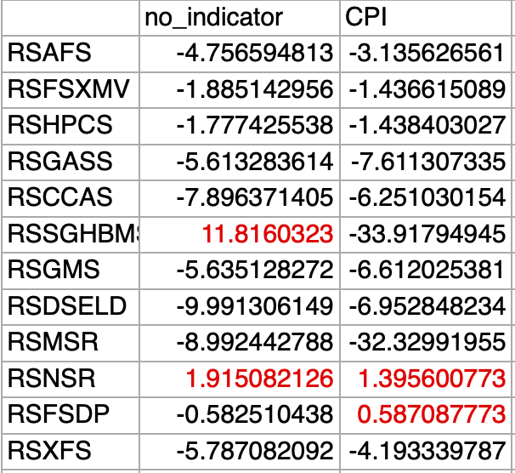
Results with Economic Indicators
CPI
We anticipated CPI to improve predictions as it’s a direct indicator of sales. CPI stands for consumer price index and measures change in prices of consumer goods and services. However, according to our results, only 2 out of 12 departments had positive results, and only half of the datasets had slightly better results.

Slide 14
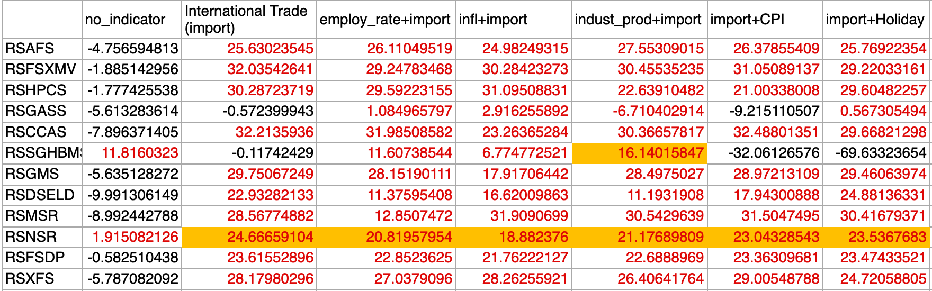
What Worked
International trade (Imports)
This makes sense because growth in national imports indicates sustainable trade and economic growth, thus reflects sales effectively.
11 out of 12 departments had larger percentage of variance explained. Interestingly, when combined with inflation or employment rate, all the departments gave positive results.

Slide 15
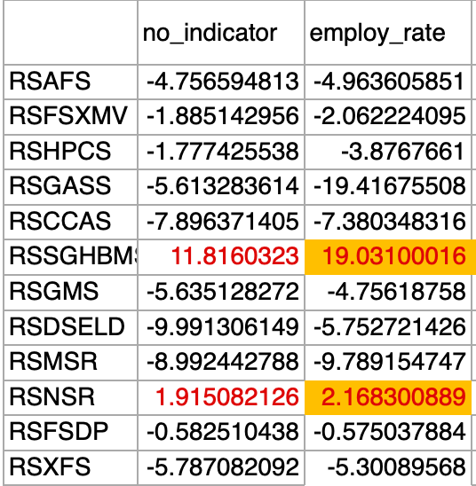
What Worked:
Employment rate
For the two departments with positive values before adding indicators, we see an increase in percentage of variance when employment rate is added as a regressor.
This is intuitive because people have more disposable income when employment rate increases and thus it impact sales.

Slide 16

Adding Prophet
Facebook’s automatic forecasting library
Notes:
Hello! My name is Stephanie and I’m from the derivatives group. Earlier this week Amy and I were tasked with learning Facebook Prophet, which is a forecasting procedure that provides fast and completely automated forecasts that can then be hand tuned. Additionally, since the derivatives group was already experimenting with using discrete derivatives, that is in this case, the current sales value subtracted by the past sales value, we wanted to see if using derivatives as regressors and in conjunction with economic indicators as regressors would provide a more accurate sales model.

Slide 17
Prophet Results: 1
Retail Food and Trade Services
 | 0 | 85.84408734336500 | 1 | 83.8315085595319 | 2 | 80.76287499634180 | 3 | 71.81338350743870 | 4 | 41.85429098918460
break_inflate10 | 0 | 91.44002850235 | 1 | 91.3115258801422 | 2 | 85.40756723608370 | 3 | 82.27235253394060 | 4 | 55.77850296793950
employ_rate | 0 | 86.22128442902650 | 1 | 84.34831844257630 | 2 | 78.37876332748290 | 3 | 76.56133845570140 | 4 | -5.1037763552540100
indust_prod | 0 | 90.03576677175450 | 1 | 88.1627132104152 | 2 | 78.66149793934520 | 3 | 66.79450064874120 | 4 | 4.086179760037690
mortgage_rate30 | 0 | 88.3130377475048 | 1 | 84.69090522994970 | 2 | 80.71968276440360 | 3 | 69.8339464298736 | 4 | 18.142116709863500
Sticky_Price_Cpi | 0 | 84.75282779598920 | 1 | 81.74374565854780 | 2 | 78.83720934415450 | 3 | 70.4204609316601 | 4 | 15.508672674072100
International_Trade | 0 | 86.99495300334960 | 1 | 87.45069995195600 | 2 | 86.38992129732490 | 3 | 78.20428815032830 | 4 | 47.03826587040010
Med_Cpi | 0 | 85.38142424139760 | 1 | 82.7592851677526 | 2 | 78.32615194357140 | 3 | 76.9089212170187 | 4 | 54.27157059788700
CPI | 0 | 89.8713869973862 | 1 | 89.00227385866220 | 2 | 85.48473770614330 | 3 | 75.40204924216020 | 4 | 65.22510213569280
Ran all permutations of all economic indicators and derivatives up to four for each industry from 2010-2019.
Notes:
So essentially, what we did is rewrite the economic indicators group’s code with Prophet instead of tensorflow to accomplish the same tasks and compare the effectiveness of each model. And as you can see, here are the results: our code made predictions all permutations of economic indicators and derivatives up to four for each industry from 2010-2019. Here, as an arbitrary example, you can see the chart for the retail food and trade services industry. So reading along the top right, you see that prophet, using zero indicators and no derivatives, managed to make a prediction with around 85.9% variance explained. And here more towards the bottom, you can see that using international trade and four derivatives regressors yielded around 47% variance explained.

Slide 18
Prophet Results: 2
Best Results:
Retail Food and Trade Services
Retail Trade
Worst Results:
Gas Stations
Sporting Goods, Hobby, Musical Instruments, and Book Stores
Observations:
Inflation most consistently high economic indicator
Highest variance: low-90’s
Lowest variance: low-20’s
Three outliers
Observations:
Diminishing returns for derivatives (54/65 negative results occurred as a result of using 3 or 4 derivatives)
Notes:
From looking at our total results, we see that prophet yield the best results for retail industries and the worst results for gas stations and sporting goods, hobby, musical instruments, and book stores, which, if you’ll believe is all combined under one industry.
This could be due to the fact that retail is such a big and wide industry, especially in comparison to something like Gas stations. Thus, it makes sense that retail would be more uniformly affected by all economic indicators.
Furthermore, we found that inflation out of all the economic indicators is the most consistent regressor. The reasoning behind this is relatively apparent: inflation decreasing the value of the U.S. dollar will affect all industries, regardless of whether that is in food or hospitals or general merchandise because those companies will then have to adjust to maintain their sales and profit margins.
Some other observations we had is that adding economic indicators and derivatives generally did improve the predictions, or at least, did not affect the results very much. Eventually, using derivative regressors hits negative diminishing returns after the 2nd one and that out of the hundreds of positive predictions we had, 54 out of the total 64 negative ones occur as a result of using either 3 or 4 derivative regressors.

Slide 19

Comparison to Tensorflow
Prophet yielded much better results…for now
NONSTORE RETAILERS | No indicator | International Trade (Import) | 1 Derivative | 2 Derivatives | Import +1 1 Derivative | Import+ 2 Derivatives
Tensorflow | 1.1915 | 24.6666 | 11.7809 | 24.5420 | 27.8489 | 39.2510
Prophet | 82.5969 | 78.3303 | 82.2183 | 82.3394 | 79.2021 | 80.8244
Notes:
So, overall we can say that Facebook prophet yielded much better predictions, for now. Pictured here is a comparison of predictions by both tensorflow and prophet on nonstore retailers. Nonstore (or online) retailers is actually arguably the most accurately predicted industry by tensorflow, yet as you can see, prophet outscores those predictions significantly. However, this result is to be expected since prophet is specfically designed to be good at making sales and weather forecasts. As the group continues to tweak and refine the neural network in tensorflow, such differences can be become more trivial.

Slide 20
Summary
We found that international trade (import) is the most significant economic indicator because it makes loss much more positive for all departments.
When we used two economic indicators (combine international trade with another indicator), for each department, the loss slightly better and some combinations give all positive numbers.
We found that employment rate, industrial production index, CPI make loss slightly better in some sales datasets.
Holiday does not seem to have obvious impact on loss
Notes:
So in summary, recalling our tensorflow results, the group found that international trade to be the most significant economic indicator and that when we combine two or more indicators, it further improves our predictions. On the flip side, one of the potential regressors that was explored but ended up not working out is holidays as it did not have an obvious impact on predictive accuracy.

Slide 21
Future Plans
Expand the testing periods to post Covid
Use different models and indicators to improve results
Use datasets from different sources to expand research
Test more combinations of different layers and number of epochs
Notes:
And now that you know what we have done, this leads us to the future and our future plans. Our overarching goal was to create a sales model that can make accurate predictions even in tomoulous times like COVID and even financial crises, thus, we plan to continue to refine our neural network model by increasing the amount and timeline of data sets, the number of neurons, types of regressors, etc. until we can do just that.

Slide 22
Special Thanks
Thank you to Charles Wolf, Scott Kirila, and Alex Iosevich for their continuous support and guidance throughout the program.
Thank you to the derivatives group for helping us with the facebook prophet and derivatives testing part of our research.
Thank you Kevin Xu for giving us insight
into what last year’s group did.
Notes:
And that’s all, thank you for listening and a special thanks to the following people:

